Slide 1
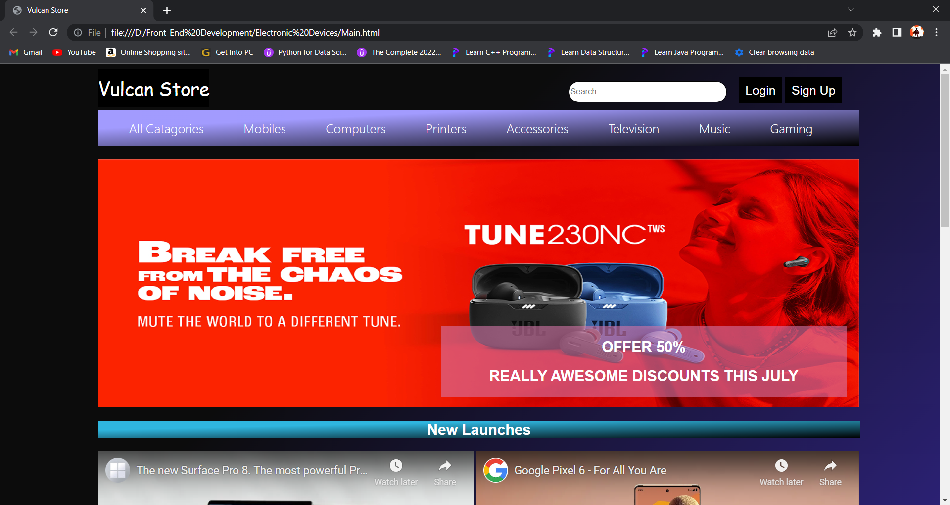
Vulcan Store
Swapnil Sharma
G17
2010992466

Slide 2
Introduction
‘VULCAN STORE’ IS AN E-COMMERCE WEBSITE PROJECT BASED ON SELLING ELECTRONIC DEVICES.
THIS WEBSITE IS MADE USING HTML5, HTML FORMS, HTML MEDIA, CSS3 and JAVASCRIPT.

Slide 3

Home Page
Home Page consists navigation bar and some useful links to other pages.

Slide 4
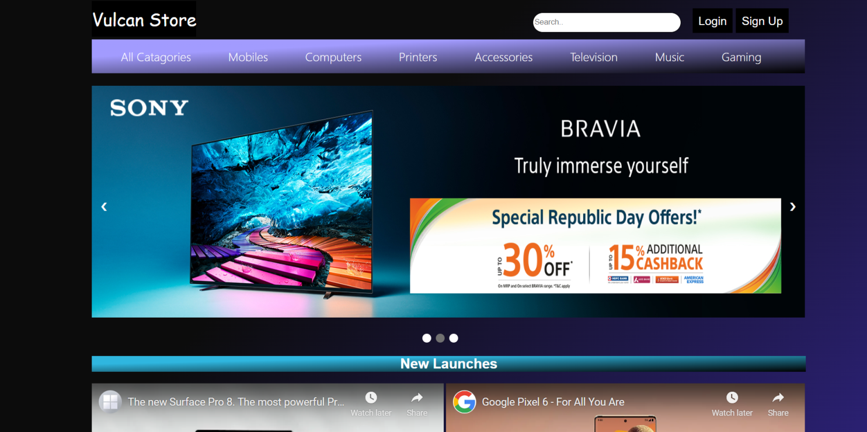
Home Page
A slider to show offers made using css and javascript.

Slide 5
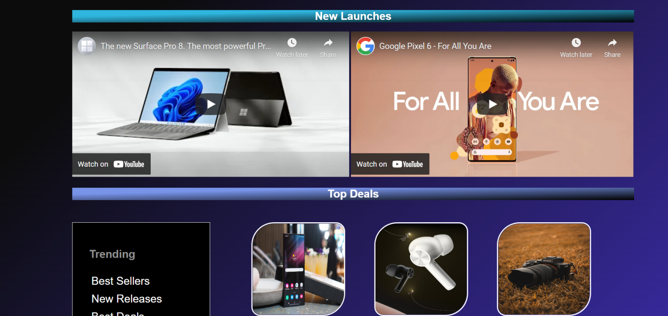
HOME PAGE
This page is created using iframe tag,div tag , image tags.
Also has a sidebar.

Slide 6
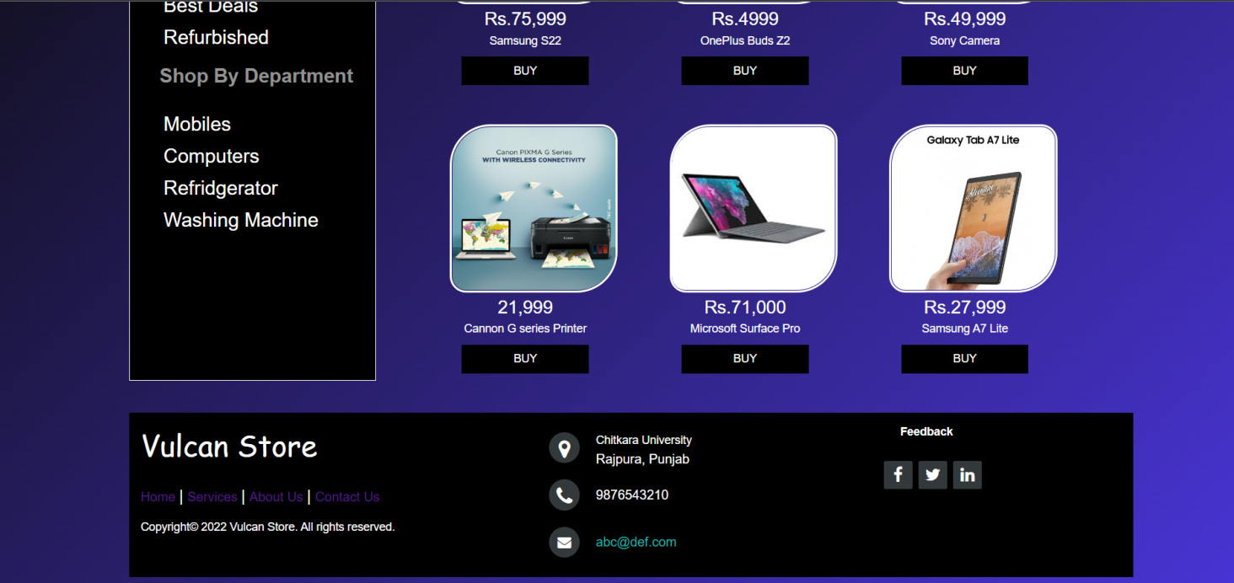
HOME PAGE
Footer has some useful links to social media sites and other pages.

Slide 7
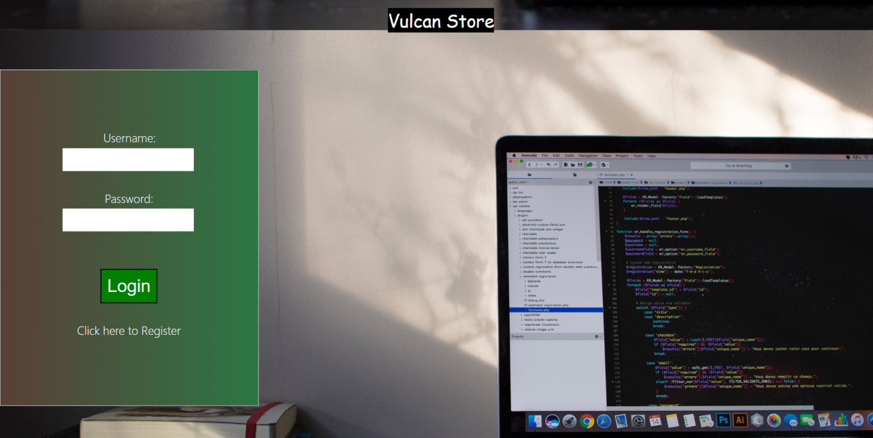
Login Page
A login page validiated by javascript.

Slide 8

Sign Up Page
A sign-up page validated by javascript.

Slide 9
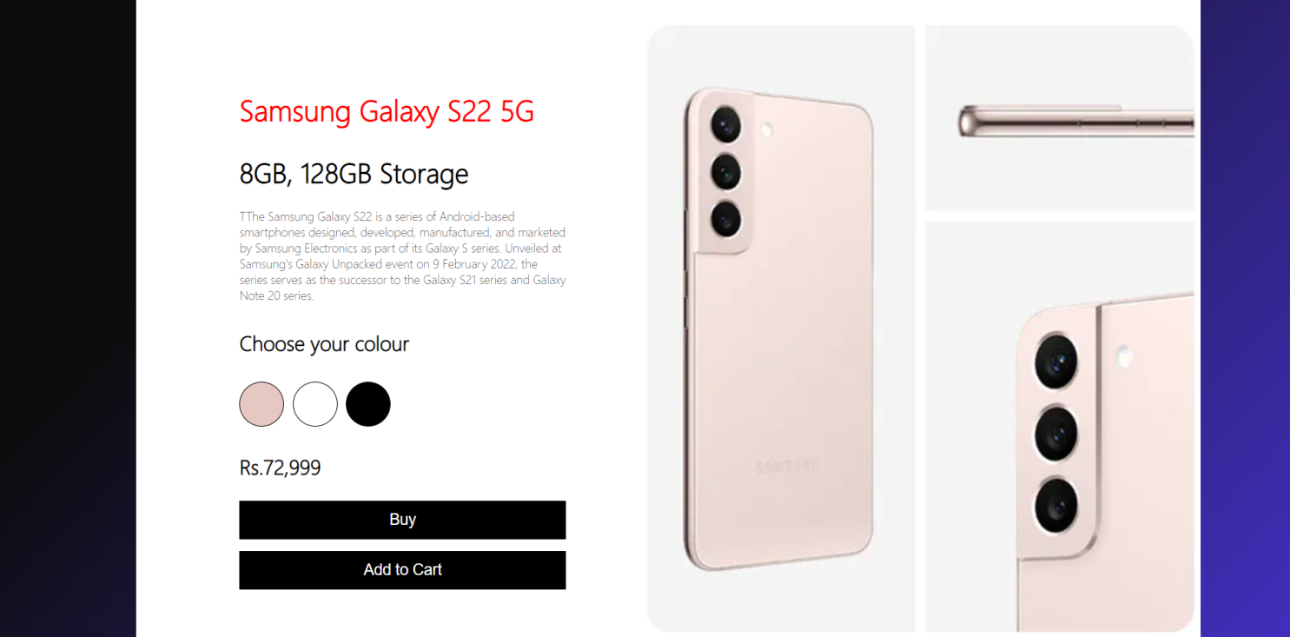
Product Page
A simple product page designed using CSS and fuctioned by javascript.

Slide 10
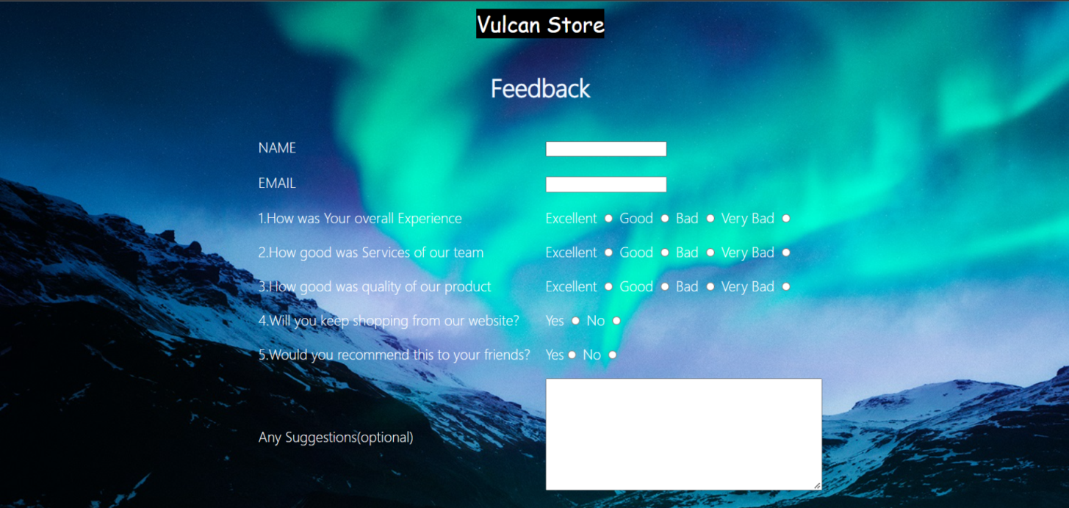
Feedback Page
A feedback form created using HTML forms.

Slide 11
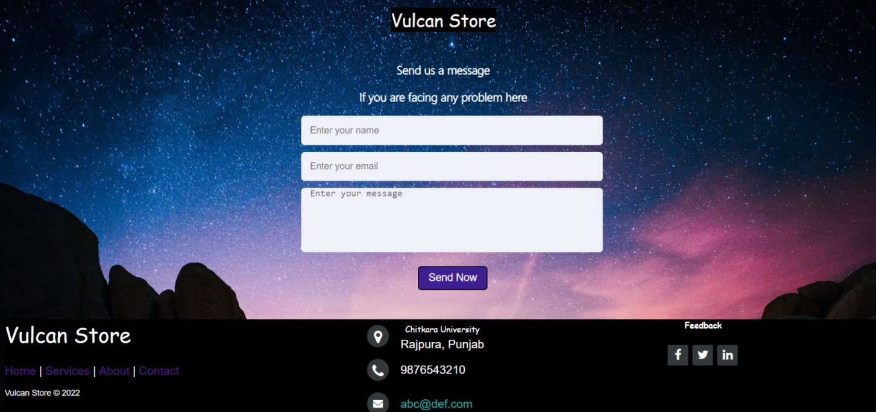
Contact Us Page
A “CONTACT US” page created using HTML forms.

Slide 12
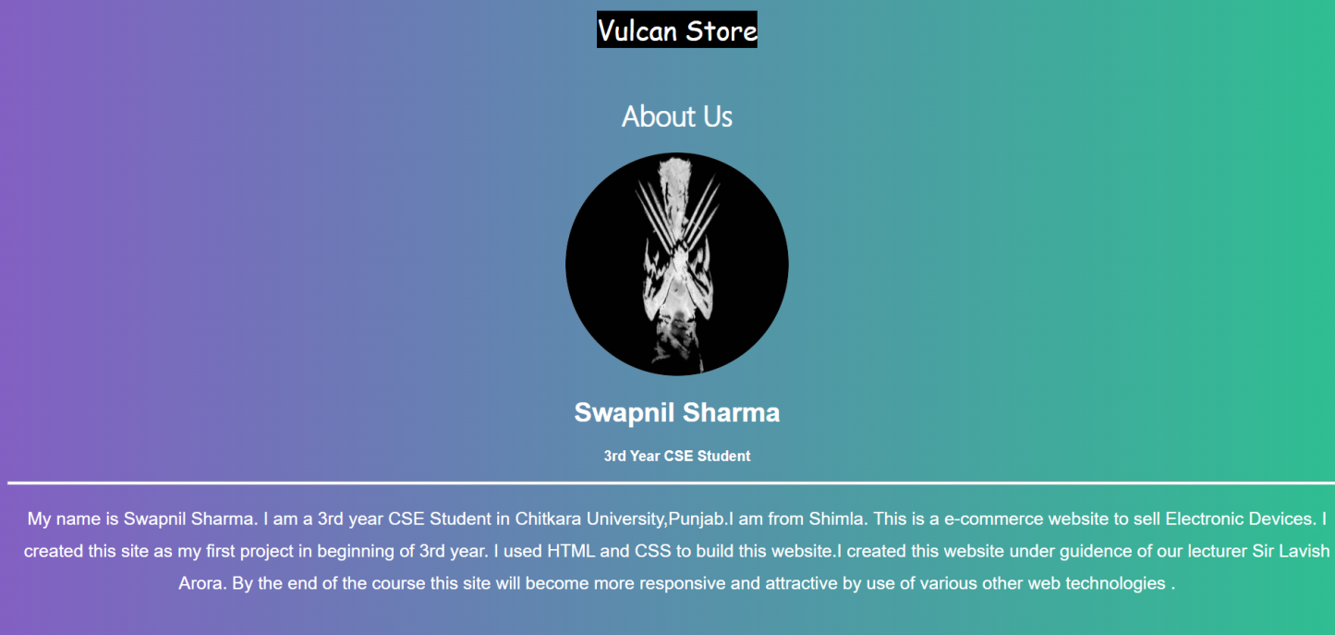
About Us Page
“About Us” page tells users about owners,workers and designers of the website.

Slide 13
THANK YOU

